Slide 1
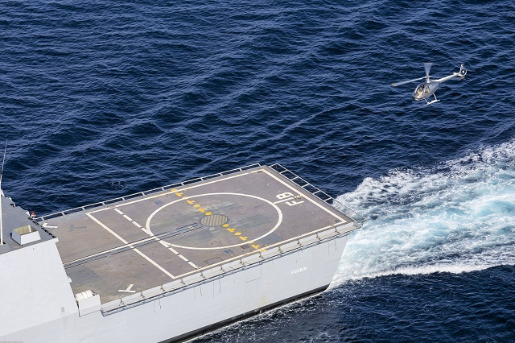
Development of an Algorithm for Autonomous landing of a UAV on a Moving Platform
Lokesh Bansal MTech. Robotics and Autonomous Systems Robert Bosch Center for Cyber Physical Systems Indian Institute of Science, Bangalore

Slide 2
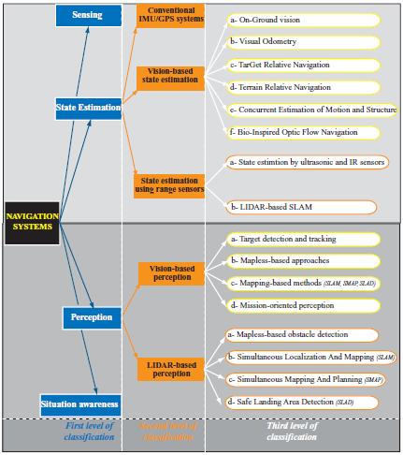
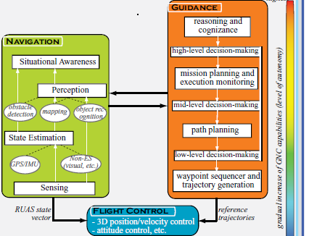
Overview of Objective

Slide 3
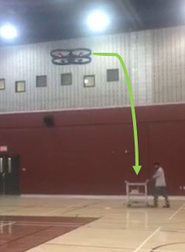
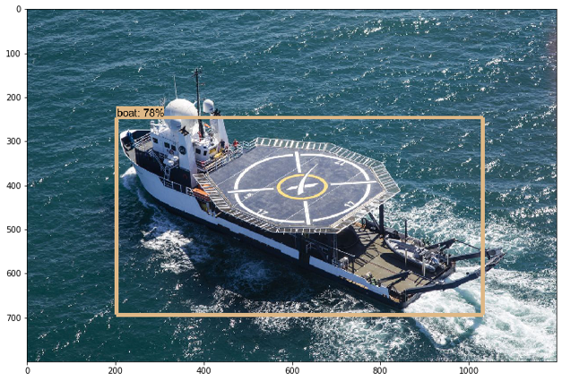
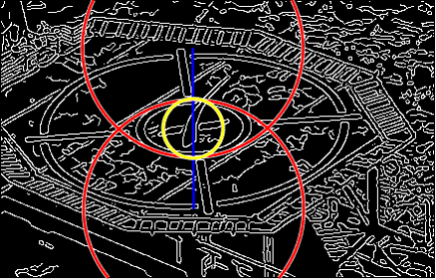
Objective- Intelligent Detection of Landing site and Autonomous Navigation and Landing of a Drone on a Moving Platform
Intelligent Detection and Tracking-
OpenCV
TensorFlow API
Feature Extraction-
Hough Transform
Canny Edge Detection
Kalman and Particle Filter
Trajectory Generation and Landing- Reinforcement Learning and PID Controller

Slide 4
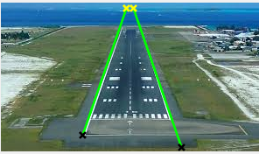
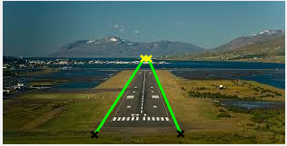
Preliminary Image Processing for Land-filed Detection and Tracking
Canny Edge detection for lines with Hough Transform is used to detect the lines
The Black and yellow end points of the lines can be used for feature extraction
Tuning is required for different images
Tuning parameters are ‘canny’, ‘theta’, houghpeaks, ‘FillGap’, ‘MinLength’
 | BW = edge(rgb, 'canny',0.2); [H, T, R]= hough(BW, 'theta', -50:50); P = houghpeaks(H,5,'threshold',ceil(0.7*max(H(:)))); x = T(P(:,2)); y = R(P(:,1)); plot(x,y,'s','color','white'); lines = houghlines(BW,T,R,P,'FillGap',600,'MinLength',10);
 | BW = edge(rgb, 'canny',0.2); [H, T, R]= hough(BW, 'theta', -50:50); P = houghpeaks(H,3,'threshold',ceil(0.4*max(H(:)))); x = T(P(:,2)); y = R(P(:,1)); plot(x,y,'s','color','white'); lines = houghlines(BW,T,R,P,'FillGap',10,'MinLength',80);
1-
2-

Slide 5
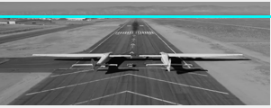
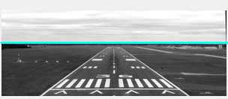
Preliminary Image Processing for Horizon Detection
Canny Edge detection for lines with Hough Transform is used to detect the Horizon
Using the detected Horizon line (blue line), attitude parameters can be determined
Tuning is required for different images
Tuning parameters are imresize(), ‘canny’, ‘theta’, houghpeaks(), ‘FillGap’, ‘MinLength’
Horizon Detection view | Specifications in Matlab Code
 | R = imresize(A, [115 300]); I = rgb2gray(R); BW = edge(I, 'canny', 0.1); %hough transform to find the lines [H, T, R] = hough(BW); P = houghpeaks(H, 10, 'threshold', ceil(0.75*max(H(:))));
 | R = imresize(A, [115 300]); I = rgb2gray(R); BW = edge(I, 'canny', 0.145); %hough transform to find the lines [H, T, R] = hough(BW); P = houghpeaks(H, 10, 'threshold', ceil(0.75*max(H(:))));
1-
2 -

Slide 6
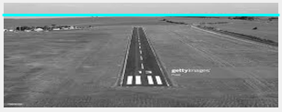
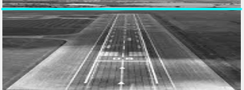
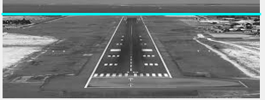
Preliminary Image Processing for Horizon Detection
 | R = imresize(A, [115 300]); I = rgb2gray(R); BW = edge(I, 'canny', 0.145); %hough transform to find the lines [H, T, R] = hough(BW); P = houghpeaks(H, 10, 'threshold', ceil(0.75*max(H(:))));
 | R = imresize(A, [115 300]); I = rgb2gray(R); BW = edge(I, 'canny', 0.145); %hough transform to find the lines [H, T, R] = hough(BW); P = houghpeaks(H, 10, 'threshold', ceil(0.75*max(H(:))));
 | R = imresize(A, [115 300]); I = rgb2gray(R); BW = edge(I, 'canny', 0.3); %hough transform to find the lines [H, T, R] = hough(BW); P = houghpeaks(H, 10, 'threshold', ceil(0.75*max(H(:))));
4-
5-
6 -

Slide 7
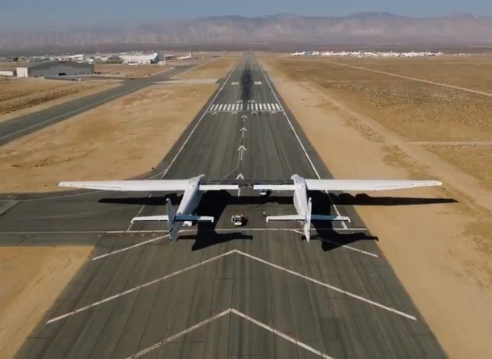
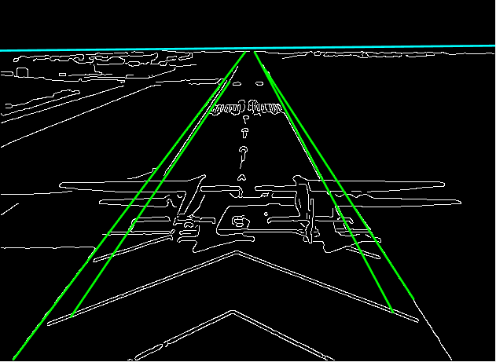
Detection of Landing Field and Horizon
Target - Detect & Track the Horizon and runway track field lines of the landing platform
The blue line - Horizon & the Green lines - track field lines
Using the Horizon detection line and the track field lines all the features like attitude, velocity can be extracted

Slide 8
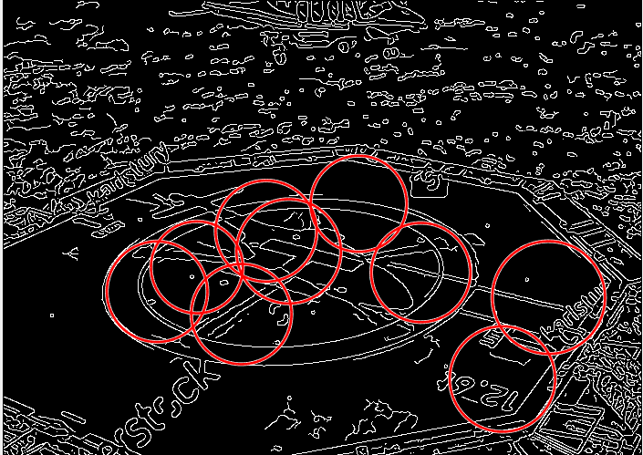
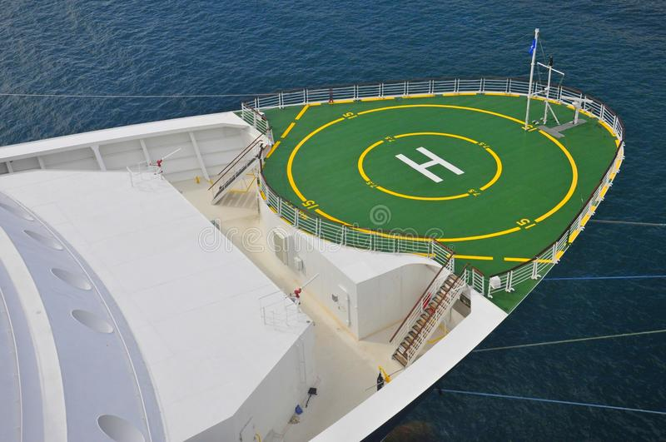
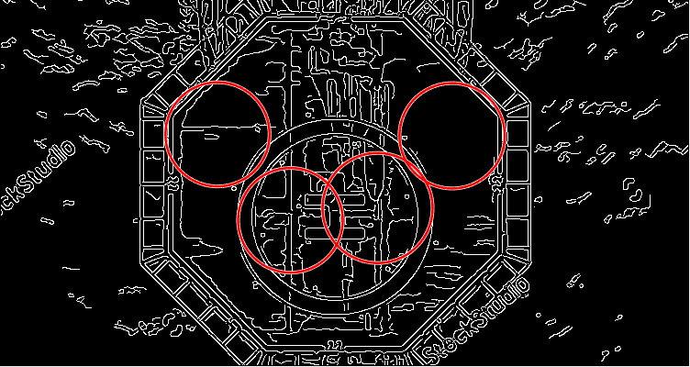
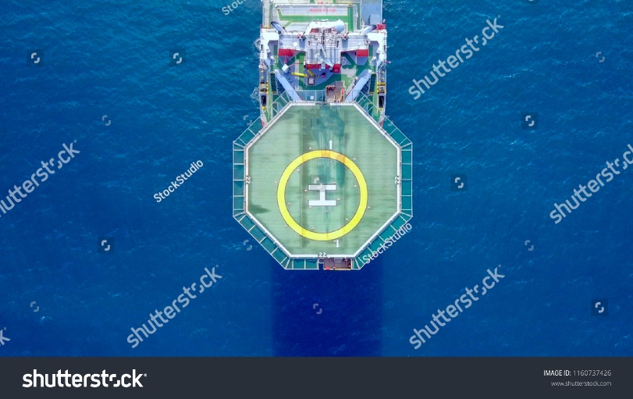
Preliminary Image Processing for Land-filed detection and tracking
Canny Edge detection with Hough Transform with a function ‘imfindcircles’ is used to detect the landing point
Using this technique, the red circles are obtained which focuses about the landing platform
Tuning is required for different images
Tuning parameters are imcrop(), ‘canny’, imfindcircles()
 |  | I = rgb2gray(A); I=imcrop(I,[300 325 700 500]); BW = edge(I,'canny',0.1); [centers, radii] = imfindcircles(I,[50 65],'ObjectPolarity','bright','Sensitivity',0.98,'EdgeThreshold',0.1);
 |  | I = rgb2gray(A); I=imcrop(I,[400 225 750 400]); BW = edge(I,'canny',0.1); [centers, radii] = imfindcircles(I,[50 65],'ObjectPolarity','bright','Sensitivity',0.98,'EdgeThreshold',0.12);
1-
2-

Slide 9
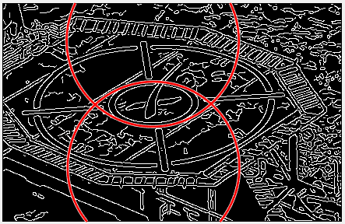
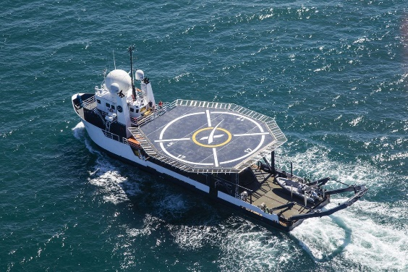
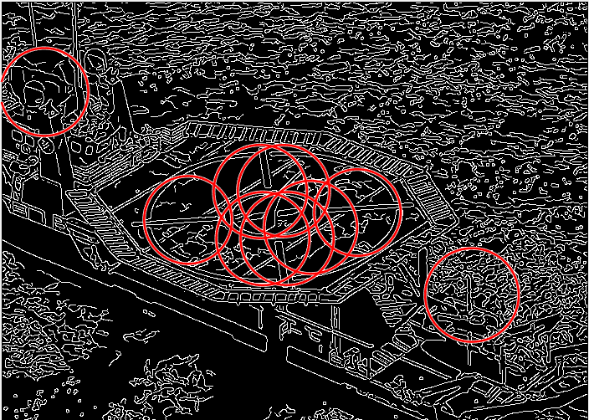
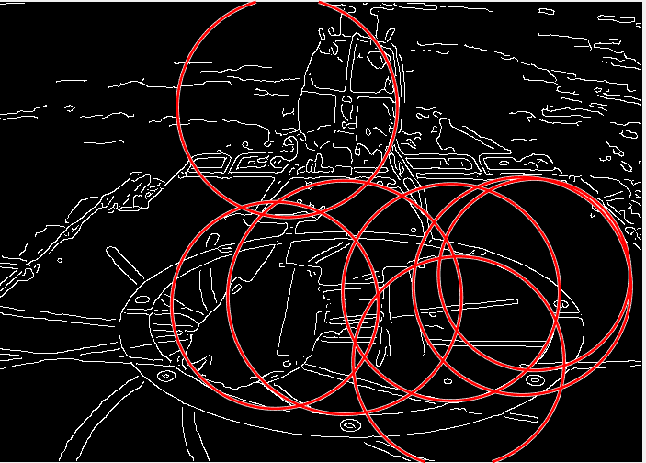
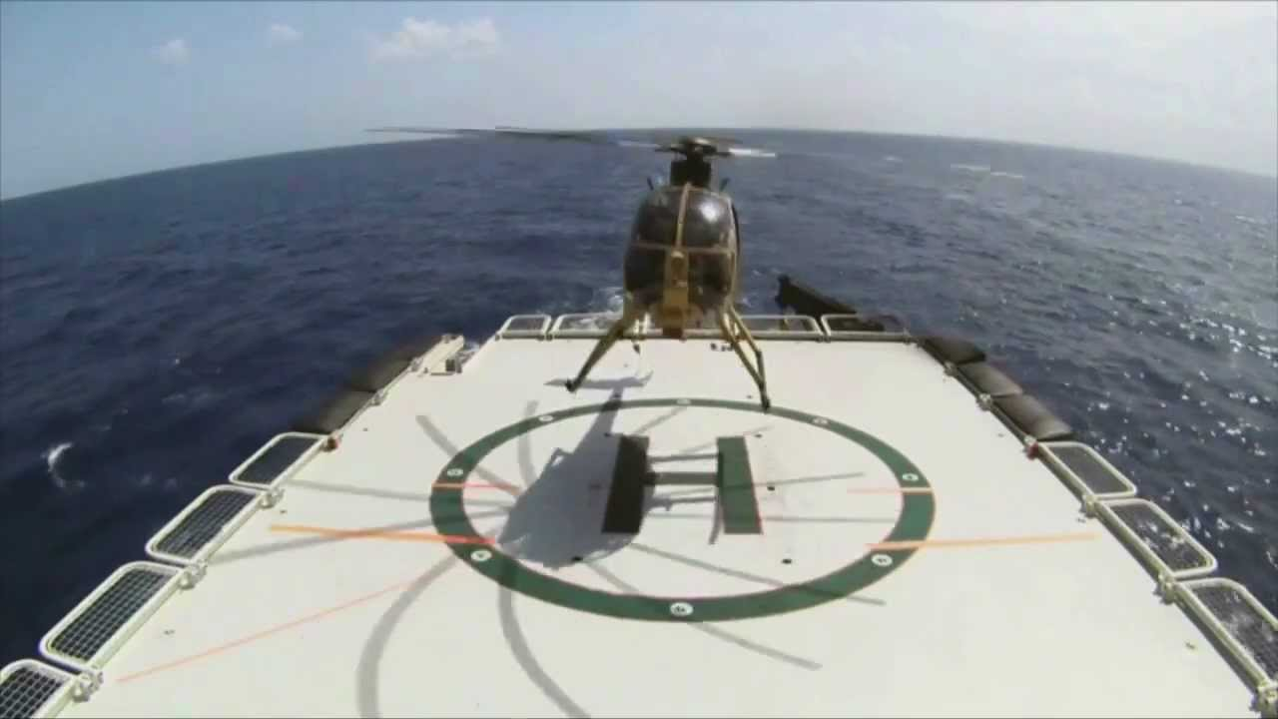
Preliminary Image Processing for Land-filed detection and tracking
Detection View | Specifications of Matlab Code
 |  | I = rgb2gray(A); I=imcrop(I,[430 275 435 280]); BW = edge(I,'canny',0.1); [centers, radii] = imfindcircles(I,[100 125],'ObjectPolarity','bright','Sensitivity',0.98,'EdgeThreshold',0.1);
 |  | I = rgb2gray(A); I=imcrop(I,[300 150 700 500]); BW = edge(I,'canny',0.1); [centers, radii] = imfindcircles(I,[50 60],'ObjectPolarity','bright','Sensitivity',0.98,'EdgeThreshold',0.1);
 |  | I = rgb2gray(A); I=imcrop(I,[300 150 700 500]); BW = edge(I,'canny',0.1); [centers, radii] = imfindcircles(I,[100 130],'ObjectPolarity','bright','Sensitivity',0.98,'EdgeThreshold',0.1);
3-
4-
5-

Slide 10
Circular Ellipsoid Detection and Tracking
To enhance the accuracy of detection, Ellipsoid detection can be used
Using this technique, the yellow and navy blue ellipses are obtained which focuses about the landing platform
The accuracy of ellipsoid detection is quite higher than the circular line detection

Slide 11
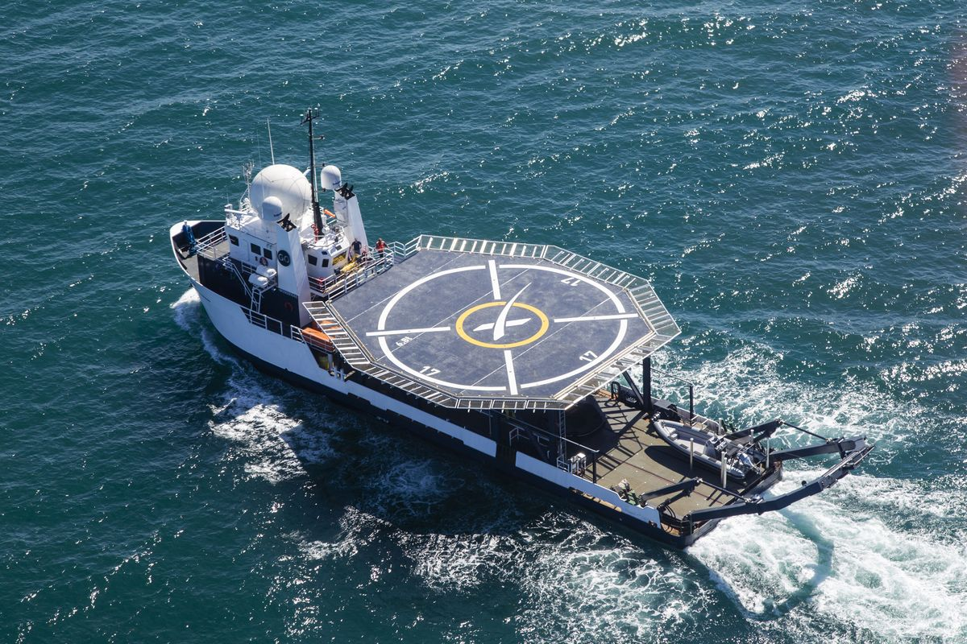
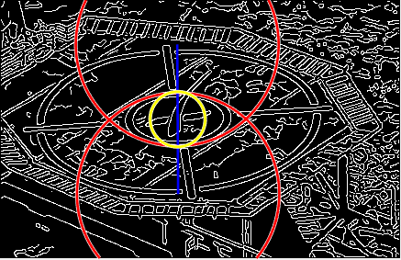
Detection of Heli-Deck on a Ship
Target- Detect and Track the center point of the Landing Platform
Hough transform + Canny Circular Edge Detection, used to draw the two red circles
The centers of the two circles are joined (blue line)
The center point of the line segment is the desired center point of the landing platform
The yellow circle is drawn taking the center of the landing platform as circle’s center

Slide 12
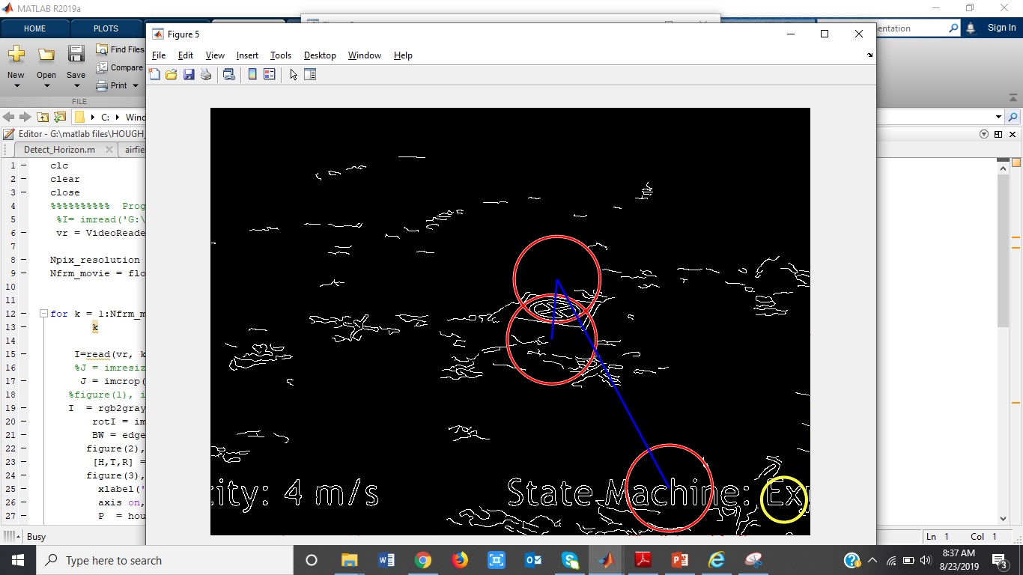
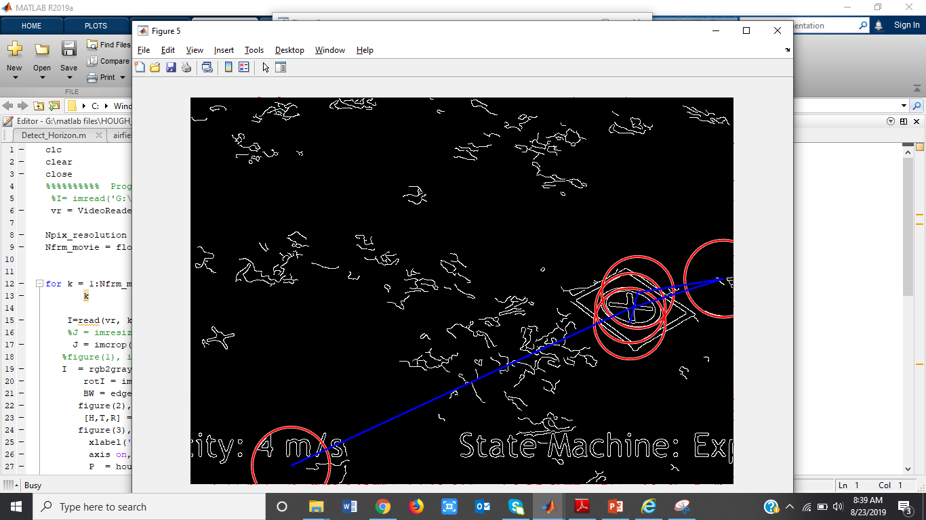
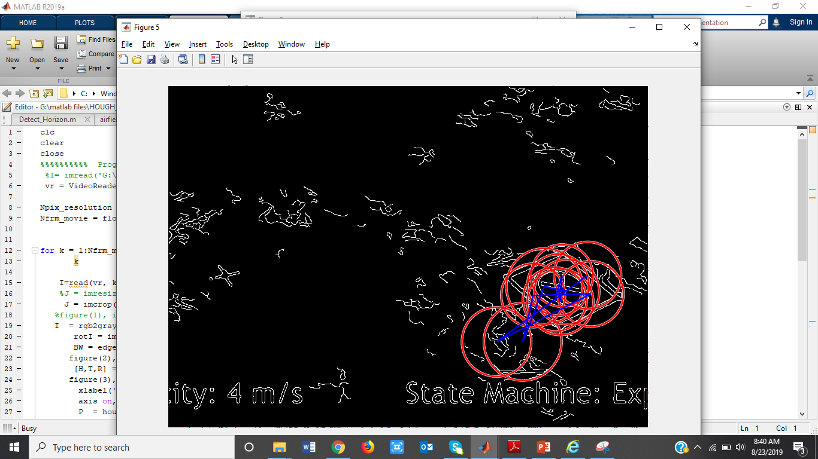
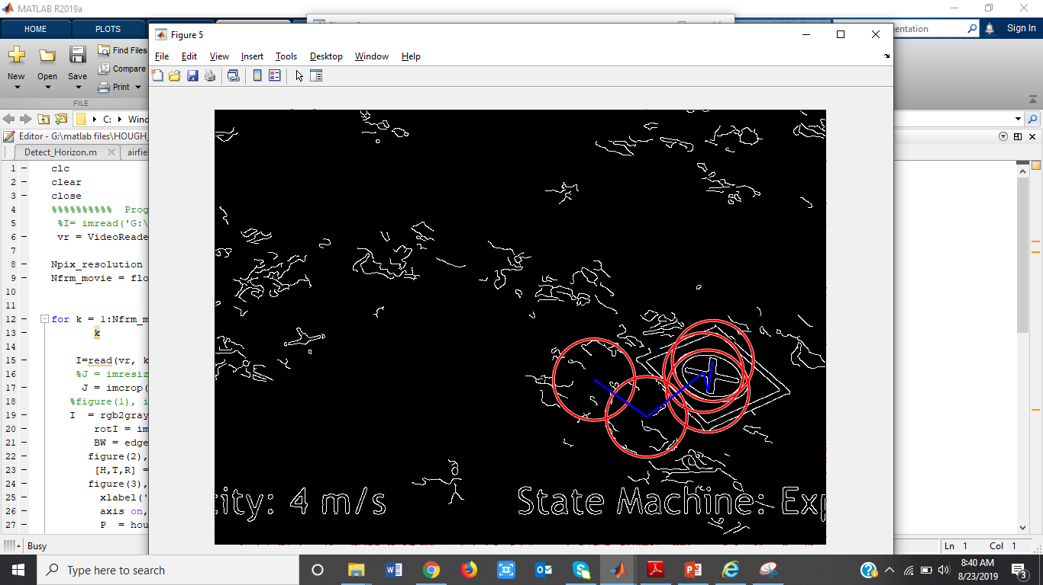
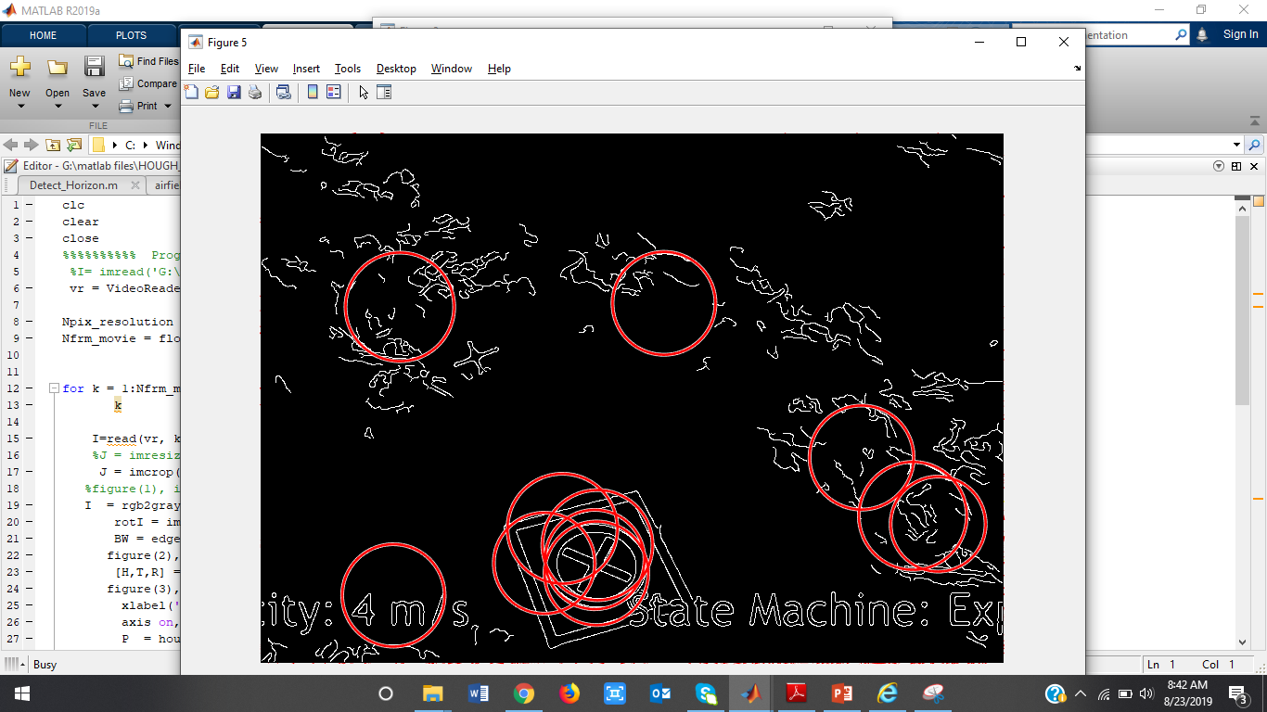
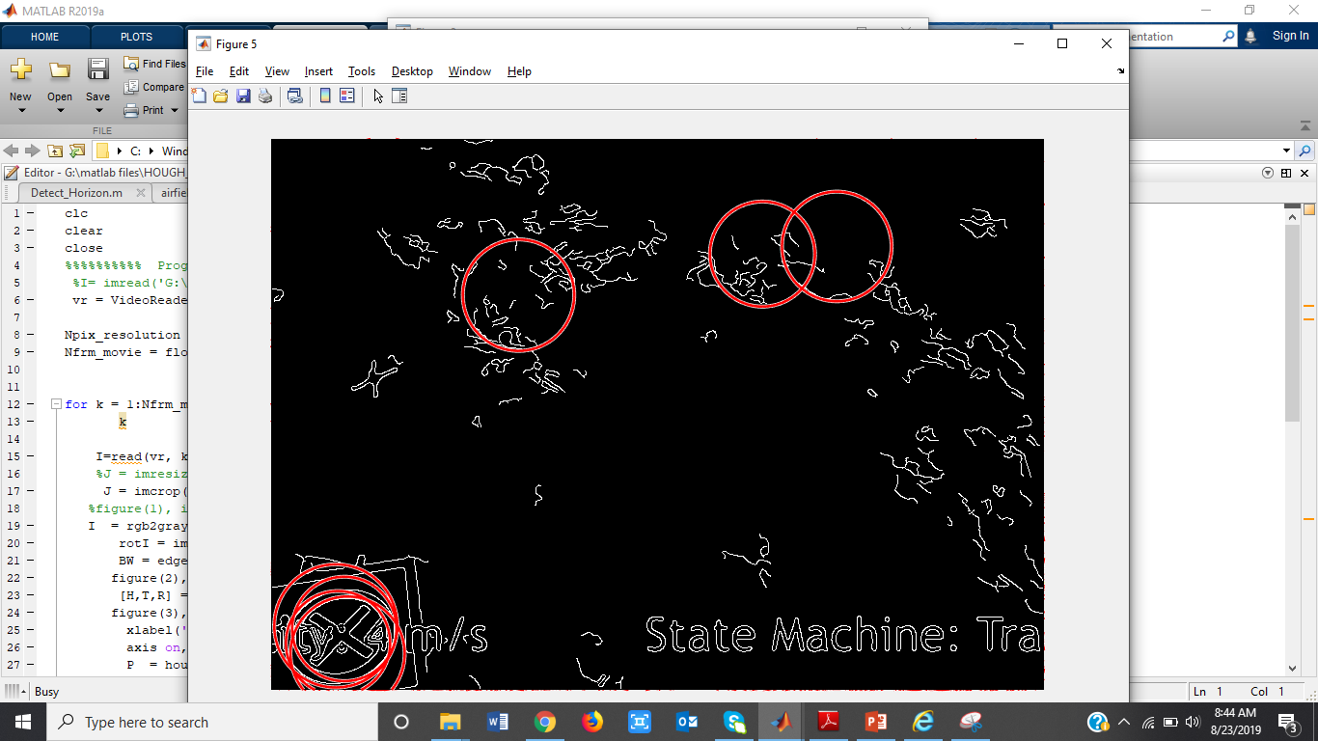
Preliminary Video processing for Landfiled detection and tracking
The frames are from video of moving landing platform
Frame-1
Frame- n
Frame- p
Frame-k
Frame- l
Frame- 167
n, p, k, l lies in (1,167) & n < p < k < l
Total frames = 167 for 5 seconds video
The red circles focuses on the landing platform
Through the red circles, the landing platform can be detected and tracked

Slide 13

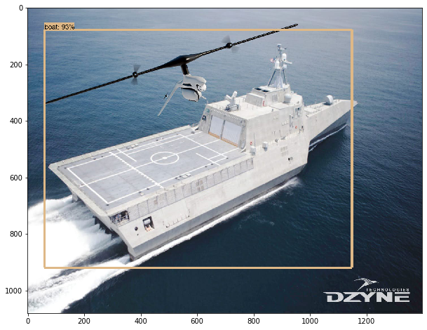
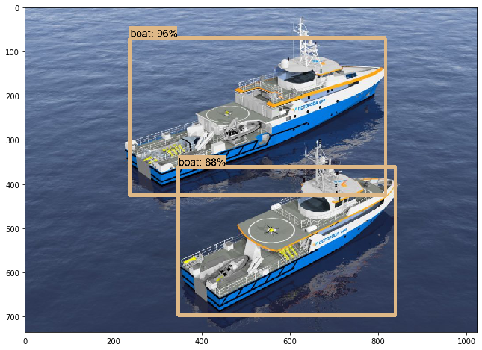
Preliminary Intelligent Object detection using Tensorflow
Fig. – Ship detection in marine environment
The ship is successfully detected and recognized.
Using Tensor Flow in Python- algorithm is developed for object detection by image processing.
Further the algorithm can be implemented with openCV library for real-time video detection.

Slide 14
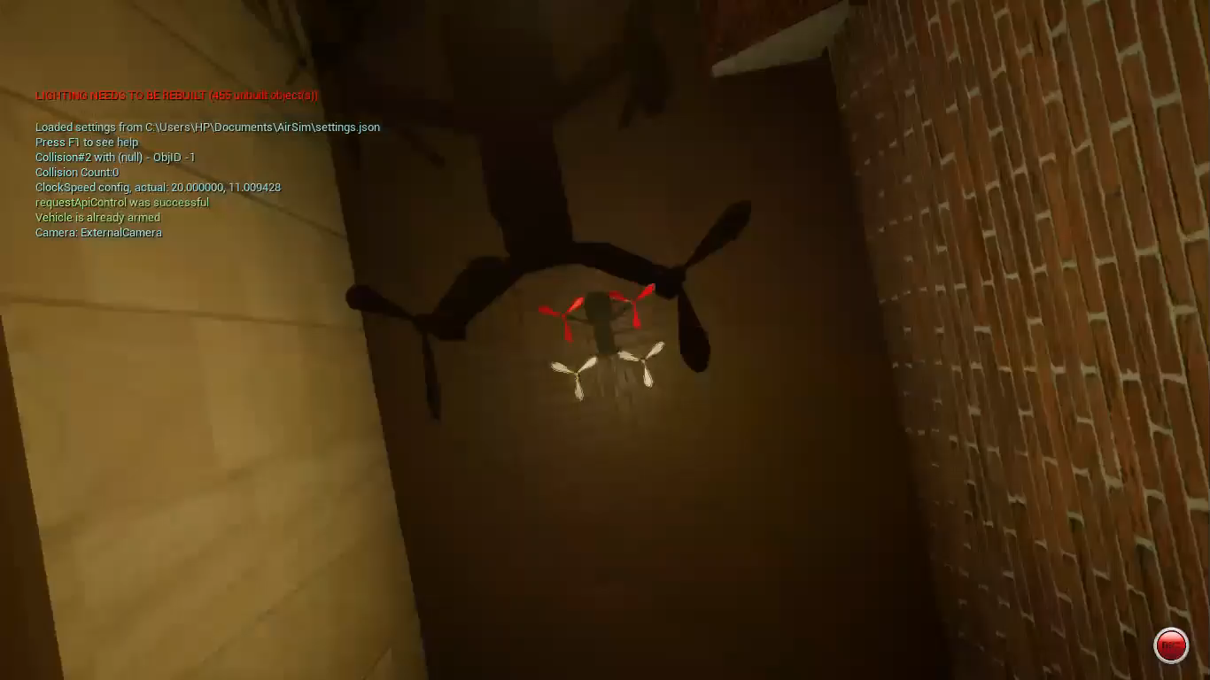
As demonstrated in the video the Reinforcement Learning Algorithm is getting trained in the simulated Environment setup by Unreal Engine and Airsim

Slide 15
Future Works
Implement the trained algorithm on a real drone.
Ensure that the animated simulated environment training will work in the real world.
Modify the Reinforcement Learning code to make autonomous landing (as of now the code is for autonomous navigation).
Formulate more sophisticated research problem and implement the developed algorithms and system on a real drone for a real world problem.

Slide 16
References
Elisa. Instrumental Landing System. [http://www.electroluminescent-provider.com/elisa-automatic-landing-system/] Accessed July 15, 2019.
Kurt. 2019. Object Detection Tutorial in TensorFlow: Real-Time Object Detection. [https://www.edureka.co/blog/tensorflow-object-detection-tutorial/] Accessed September 05, 2019.
Raksha Rao K. “Autonomous landing of a quadrotor on stationary and moving platforms using only vision from an on-board monocular camera”. Thesis. Indian Institute of Technology, Madras, India. 2018.
Farid Kendoul. “Survey of Advances in Guidance, Navigation, and Control of Unmanned Rotorcraft Systems”. Australian Research Centre for Aerospace Automation (ARCAA), Australia and CSIRO ICT Centre, Australia. 2011
Satish Kumar V., Sudesh K. Kashyap*, and N. Shantha Kumar. “Detection of Runway and Obstacles using Electro-optical and Infrared Sensors before Landing”. National Aerospace Laboratory, Bangalore, India. 2014.
Sebastian Scherer ∗, Lyle Chamberlain, Sanjiv Singh, “Autonomous landing at unprepared sites by a full-scale helicopter”. Robotics Institute, Carnegie Mellon University, Pittsburgh, PA, USA. 2012.
Damien Dusha *, Wageeh Boles, Rodney Walker, “Fixed-Wing Attitude Estimation Using Computer Vision Based Horizon Detection”. Australian Research Centre for Aerospace Automation (ARCAA), Queensland University of Technology (QUT), Brisbane, Australia. 2007.
Davide Falanga, Alessio Zanchettin, Alessandro Simovic, Jeffrey Delmerico, and Davide Scaramuzza, “Vision-based Autonomous Quadrotor Landing on a Moving Platform”. 2017. University of Zurich, Switzerland.

